Slide 1
Competitive Algorithm Calculation Testing in a Unified System
(CACTUS)
Software Plan
Presented By:
ExoNET Solutions
9/23/2011

Slide 2
Welcome
Dr. Darren Lim
Associate Professor of Computer Science
Siena College

Slide 3
Agenda
Introductions
Problem Definition
System Justification
System Constraints and Goals
Development Resources
Project Model
Project Timeline

Slide 4
ExoNET Solutions Team Members
David Purcell
Team Leader
Stephanie Del Belso
Documents Analyst
Thomas Delaney
Systems Administrator
Marco Samaritoni
Web Master
Paul Amodeo
Assistant Web Master

Slide 5
Agenda
Introductions
Problem Definition
System Justification
System Constraints and Goals
Development Resources
Project Model
Project Timeline

Slide 6
Problem Definition
Current contest system is loosely structured
Inconvenient for judges and contestants
Not easily maintained
Not fully automated

Slide 7
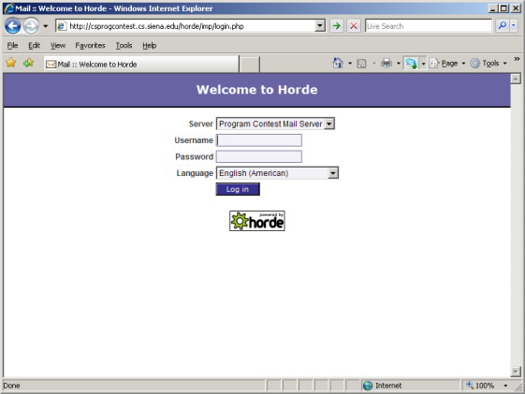
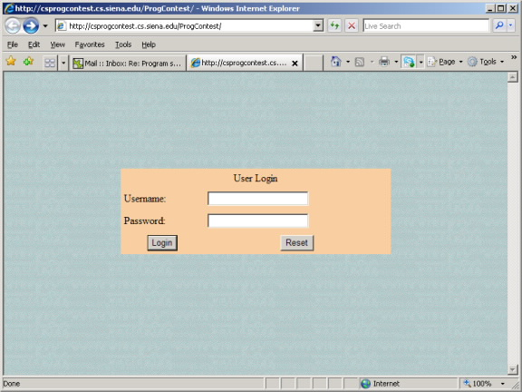
The Old System

Slide 8
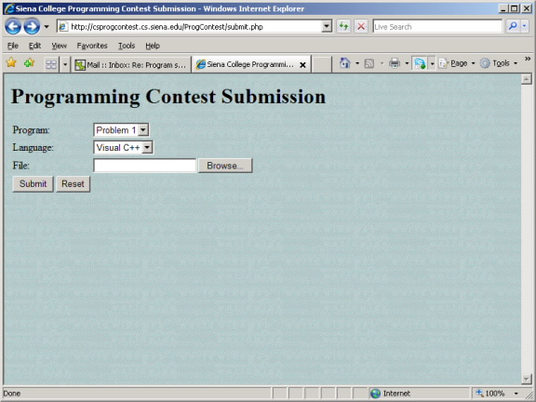
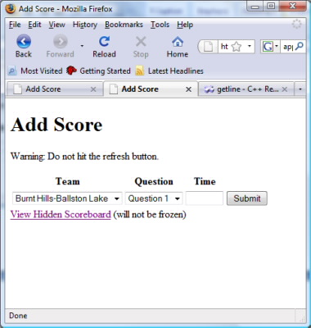
The Old System Cont.

Slide 9
Agenda
Introductions
Problem Definition
System Justification
System Constraints and Goals
Development Resources
Project Model
Project Timeline

Slide 10
System Justification
Remove unnecessary complications
Easy communication between judges and contestants
Quick response time
Contest smoothness and scalability

Slide 11
Agenda
Introductions
Problem Definition
System Justification
System Constraints and Goals
Development Resources
Project Model
Project Timeline

Slide 12
System Constraints
Communication between judges and contestants
Accepted Programming Languages
Real Time updates and loss prevention
Record detailed contest history

Slide 13
System Goals
Easy problem submission and judging
Increased reliability
Increased maintainability and extensibility
Intuitive and visually appealing interface
Simplicity in contest creation and participation

Slide 14
Agenda
Introductions
Problem Definition
System Justification
System Constraints and Goals
Development Resources
Project Model
Project Timeline

Slide 15
Development Resources
Software
Mozilla Firefox
BlueJ
Netbeans
Google Chrome
Macromedia Dreamweaver
Microsoft Office

Slide 16
Development Resources
Languages and People
Languages:
Java
SQL
CSS
HTML
JavaScript
People:
Dr. Darren Lim
ExoNET Solutions

Slide 17
Agenda
Introductions
Problem Definition
System Justification
System Constraints and Goals
Development Resources
Project Model
Project Timeline

Slide 18
Project Model (Waterfall Model)
Development
and
Testing

Slide 19
Agenda
Introductions
Problem Definition
System Justification
System Constraints and Goals
Development Resources
Project Model
Project Timeline

Slide 20
Project Timeline

Slide 21
What is next?
Obtain details from client meetings
Additional project research
Requirements Specification – October 28th, 2011

Slide 22
Thank You.
Questions? Comments?

